Slide 1
Linear Regression
Linear Regression is a supervised machine learning algorithm where the predicted output is continuous and has a constant slope. It's used to predict values within a continuous range, (e.g. sales, price)
Simple Linear Regression model.
Lasso Regression.
Logistic regression.
Support Vector Machines.
Multivariate Regression algorithm.
Multiple Regression Algorithm.

Slide 2
Simple Linear Regression model
Simple linear regression is a type of regression analysis where the number of independent variables is one and there is a linear relationship between the independent(x) and dependent(y) variable. ... The motive of the linear regression algorithm is to find the best values for a_0 and a_1.

Slide 3
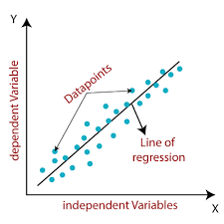
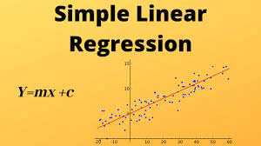
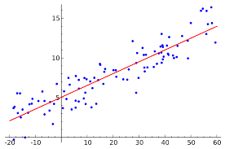
Simple Linear regression

Slide 4
X = dataset.iloc[:,:-1].values y = dataset.iloc[:,-1].values
#dividing into train and test
from sklearn.model_selection import train_test_split
X_train, X_test, y_train, y_test = train_test_split(X, y, test_size=0.3, random_state=0)
from sklearn.linear_model import LinearRegression
regressor = LinearRegression()
regressor.fit(X_train,y_train)
LinearRegression(copy_X=True, fit_intercept=True, n_jobs=None, normalize=False)
#prediction
y_pred = regressor.predict(X_test)

Slide 5
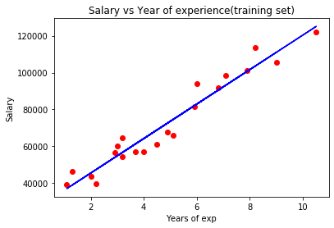
plt.scatter(X_train,y_train,color = 'red’)
plt.plot(X_train,regressor.predict(X_train),color = 'blue’)
plt.title('Salary vs Year of experience(training set)’)
plt.xlabel('Years of exp’)
plt.ylabel('Salary’)
plt.show()

